Slide 1
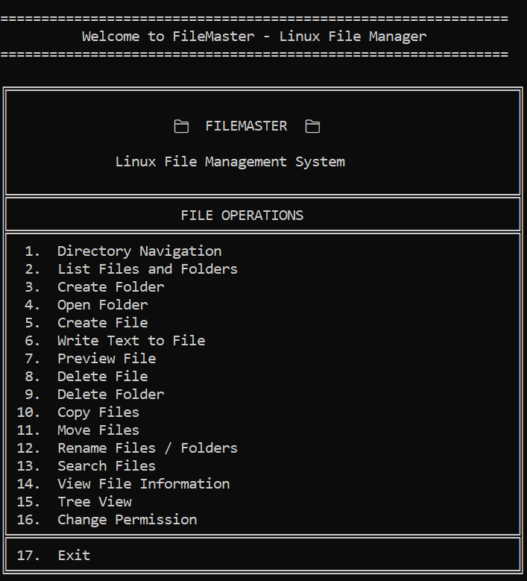
FileMaster:
A Linux File Management System
A Menu-Driven File Management System Using C and Linux
Role No | Name
2510030306 | Katna Abhineshwar
2510030246 | Mallala Sri Charan
2510030412 | Akhil Sagar
2510030298 | Abhilash Goud
Academic Year 2026–2027

Slide 2
Problem Statement
Linux has powerful file commands
Users must remember commands and syntax
Paths and navigation confuse beginners
Each operation needs a different command
Information and permissions need more commands
Manual typing causes syntax errors
No simple unified interface for beginners
Traditional CLI
FileMaster
$ touch a.txt
$ mkdir ram
$ cp a b
$ mv a b
$ find . -name x
$ chmod 755 a
1. Create File
3. Create Folder
10. Copy Files
11. Move Files
13. Search Files
16. Change Permission
FileMaster aims to simplify Linux file management through a user-friendly, menu-driven C application.
2

Slide 3
Objectives
🐧
☰
📄
1. Develop a Linux-based file management application
2. Provide a menu-driven interface
3. Perform file and directory operations efficiently
⚙
🔒
🎓
4. Implement Linux/POSIX system calls
5. Manage file information and permissions
6. Demonstrate OS and System Programming concepts
3

Slide 4
Existing System vs Proposed System
Existing Linux CLI
FileMaster
Multiple commands
Syntax memorization
Manual paths
Separate operations
Separate permission commands
bash
Single interface
Numbered menu
Simple input
Integrated operations
Permissions, search, tree view
FileMaster
$ cd Documents
$ ls -l
$ cp a.txt ../b.txt
$ chmod 644 b.txt
1. Directory Navigation
10. Copy Files
13. Search Files
16. Change Permission
Complex CLI → Simplified FileMaster
Beginner friendly: fewer commands to remember
4

Slide 5
Research Background
File Operations
Directory & Namespace Management
Filesystem Scalability
Metadata & Permissions
Reliability & Recovery
Crash Consistency
Research Timeline
2013
2024
2025
📄 A Study of Linux File System Evolution
FAST 2013
📄 SquirrelFS (OSDI 2024)
BfFS (2024)
📄 WOLVES (OSDI 2025)
F2FSJ (OSDI 2025)
5

Slide 6
What We Learned from Existing Research
SquirrelFS
Crash consistency
FileMaster: Safe checks before changes
BfFS
Large-scale file organization
FileMaster: Recursive search and tree view
WOLVES
Metadata consistency
FileMaster: File information and permissions
F2FSJ
Fine-grained recovery
FileMaster: Error and input handling
Research → File Operations → Scalability → Metadata → Reliability → Recovery
6

Slide 7
Research Gap
Existing Research
Research
Scalability
Reliability and metadata
Crash recovery
Filesystem performance
Internal filesystem mechanisms
Advanced Filesystem Problems
User-Level Gap
Missing
A simple, lightweight, educational interface integrating common Linux file and directory operations.
FILEMASTER
7

Slide 8
Proposed FileMaster System
USER
FileMaster Provides
File Management
Directory Management
FILEMASTER MENU
Search
File Information
OPERATION MODULE
LINUX/POSIX API
Permissions
File Preview
KERNEL / VFS
Tree View
LINUX FILE SYSTEM
8

Slide 9
System Architecture
USER – Types a menu choice
System Calls
open()
read()
MENU-DRIVEN INTERFACE – Reads and validates input
write()
close()
FILEMASTER MODULES – C modules
mkdir()
unlink()
LINUX SYSTEM CALLS – POSIX API
rename()
chmod()
lstat()
opendir()
LINUX KERNEL / VFS – Virtual File System
readdir()
LINUX FILE SYSTEM – Files and folders
9

Slide 10
Technology Stack
🐧
Operating System
Ubuntu Linux
C
Programming
C
⚙
Compiler
GCC
>_
Interface
Terminal
📚
APIs
POSIX / Linux system calls
Concepts Used
File I/O
Directory handling
Metadata
Permissions
Directory traversal
Linux VFS
10

Slide 11
Modular System Design
1. Main / Menu
5. Search
2. Directory Operations
FileMaster
>_ C + Linux
6. Permission Management
3. File Editor
7. Tree View
4. File Operations
Each module has a focused responsibility
11

Slide 12
Implemented Features
Directory
Directory
Directory
Directory
🧭 Directory Navigation
📋 List Files and Folders
➕ Create Folder
📂 Open Folder
Directory
File
File
File
🗑 Delete Folder
📄 Create File
✏️ Write Text to File
👁 Preview File
File
File
File
File
❌ Delete File
📑 Copy Files
➡️ Move Files
🏷 Rename Files / Folders
Search / Info
Search / Info
Security / View
Security / View
🔍 Search Files
ℹ️ View File Information
🔒 Change File Permissions
🌳 Tree View
Plus Exit (option 17) – 16 operations implemented
12

Slide 13
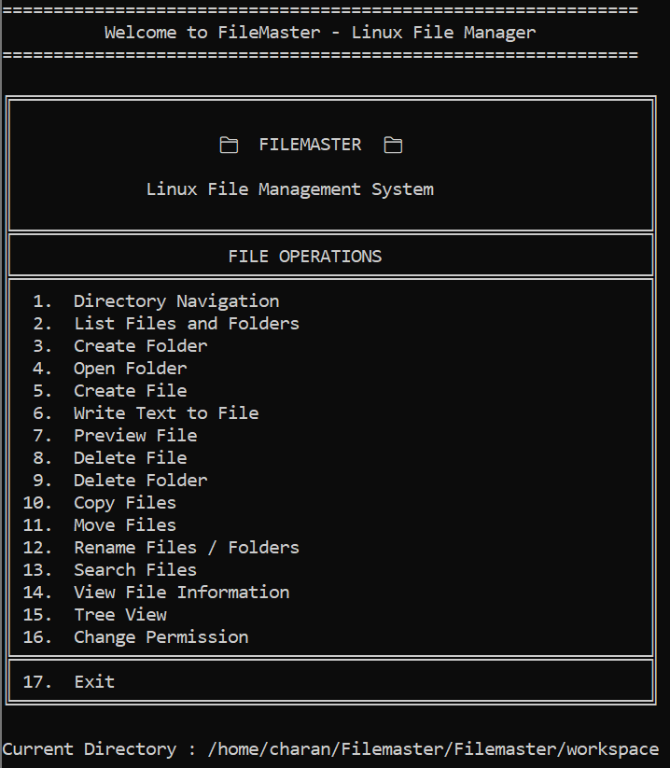
FileMaster Main Menu — Actual Output
17 numbered options
Grouped under FILE OPERATIONS
Shows current directory
Invalid choices are rejected
Menu-driven: no commands to memorize
13

Slide 14
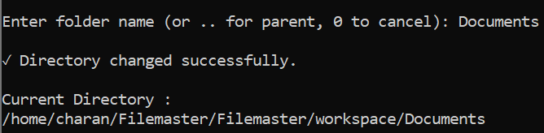
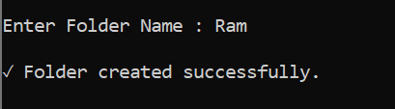
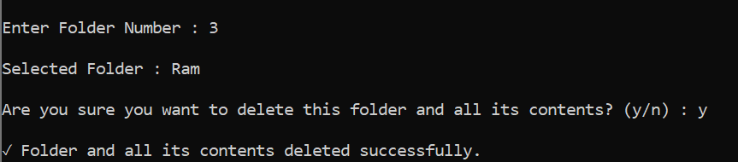
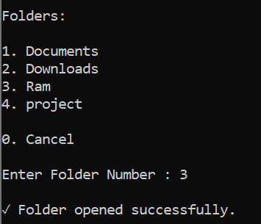
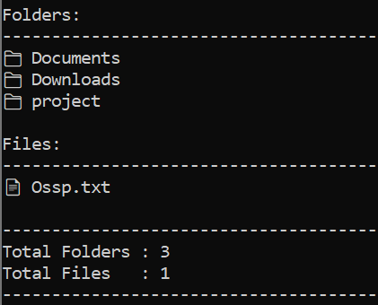
Directory Operations — Output
Navigation + List
Create + Open
Delete Folder
14

Slide 15
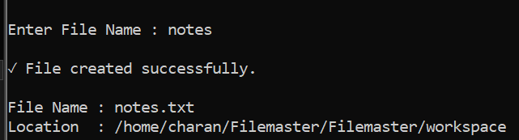
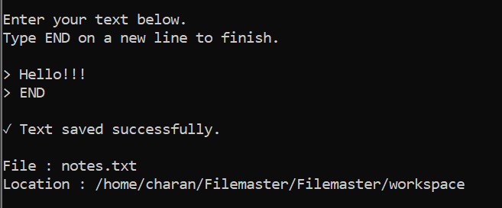
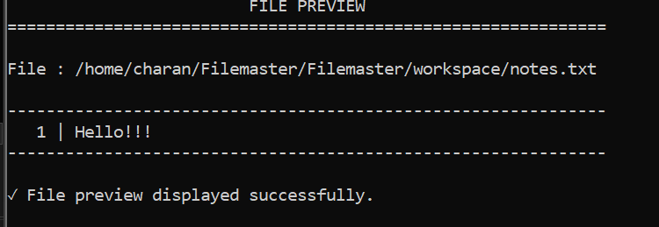
File Creation and Editing — Output
1. Create
2. Write
3. Preview
Create File
Write Text
Preview File
15

Slide 16
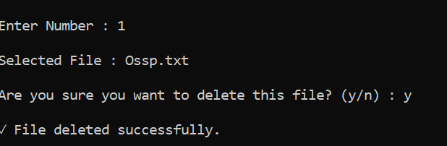
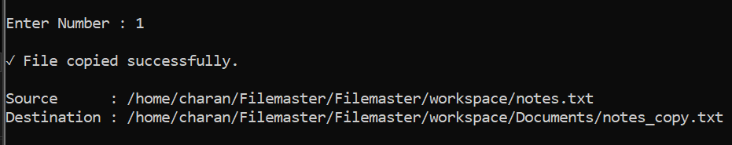
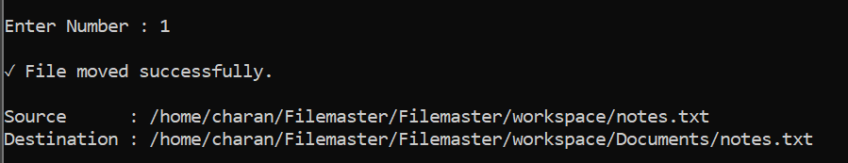
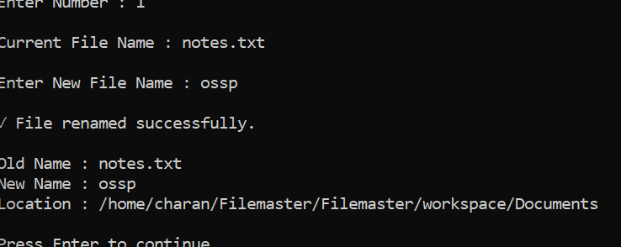
File Operations — Output
Delete
Copy
Move
Rename
16

Slide 17
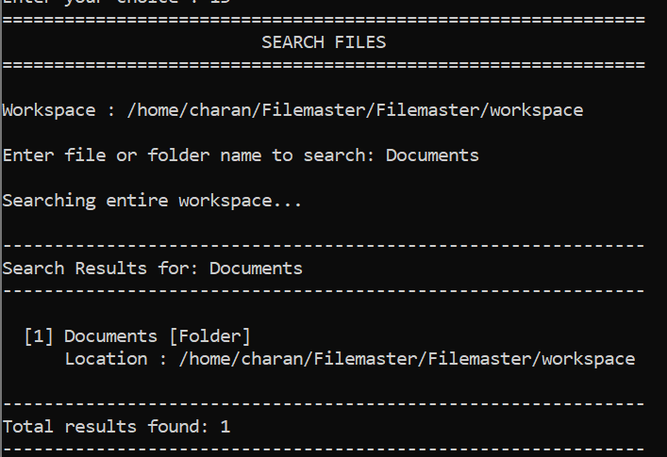
Search Files and Folders — Output
Search Files and Folders
17

Slide 18
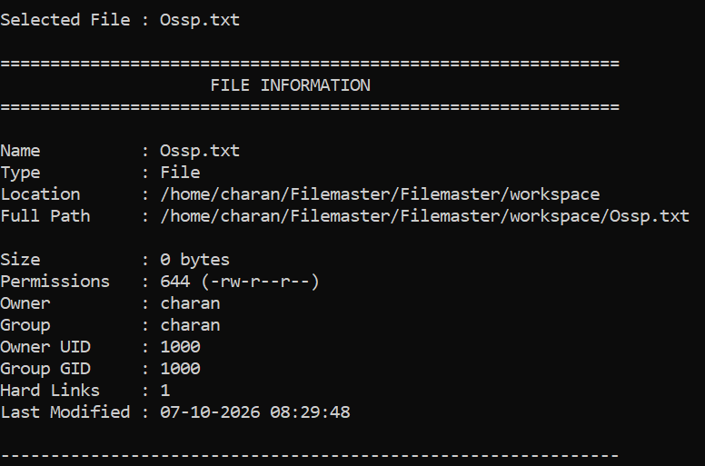
View File Information — Output
View File Information
📄
Name / Type
💾
Size
🔒
Permission
👤
Owner
👥
Group
🕒
Time
18

Slide 19
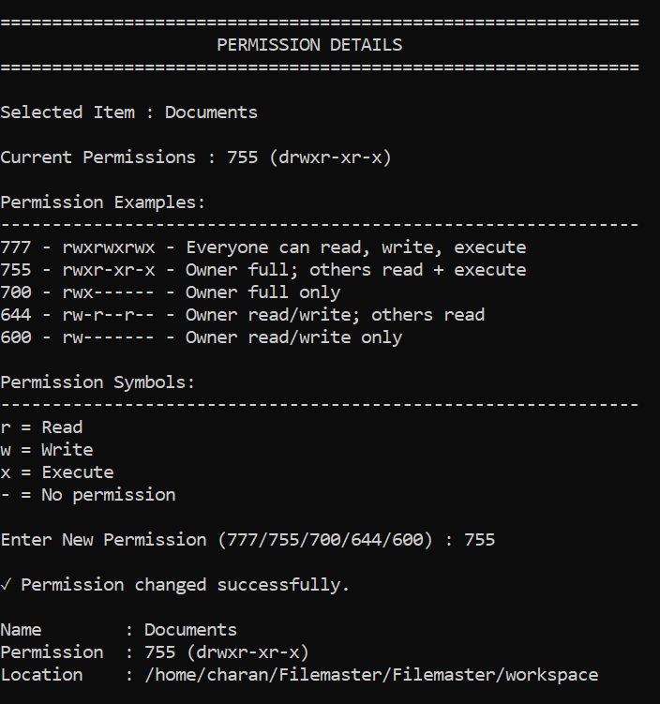
Linux File Permissions — Output
File Permission
OWNER
GROUP
OTHERS
rwx
r-x
r-x
7
5
5
chmod(path, 0755)
chmod() changes permission bits
Each digit = owner, group, others
r=4 w=2 x=1
19

Slide 20
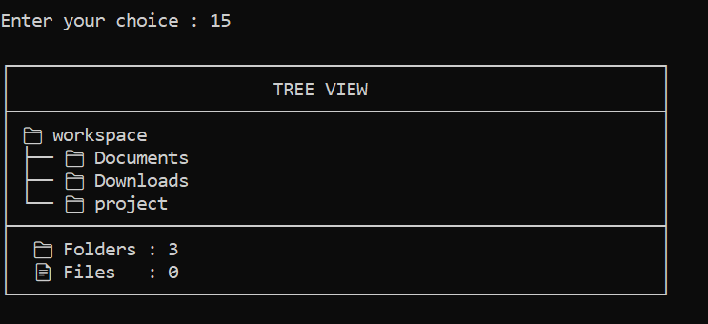
Tree View — Output
Tree View
20

Slide 21
Recursive File and Folder Management
Finds files in nested folders
No need to open every folder
Search traverses the hierarchy
Delete Folder removes contents
Tree View shows structure
Info and Permission reach nested items
workspace
├── Documents
│ └── ram
│ └── notes.txt
├── Downloads
│ └── test.txt
└── project
└── C
└── main.c
Folder → subfolder → file: traversal visits every level
21

Slide 22
Linux System Calls Used
Operation | System Call
Create / Open | open()
Read | read()
Write | write()
Close | close()
Create Directory | mkdir()
Delete | unlink()
Move / Rename | rename()
Permissions | chmod()
Metadata | lstat()
Directory | opendir() / readdir()
USER
FILEMASTER
POSIX API
LINUX KERNEL
VFS
FILE SYSTEM
22

Slide 23
Program Execution Flow
START
Open Workspace
Display Menu
Read User Choice
Validate Input
Press Enter
Display Result
Linux/POSIX Operation
Execute Module
Select Operation
Return to Menu
Exit?
YES → END
NO → back to Display Menu
23

Slide 24
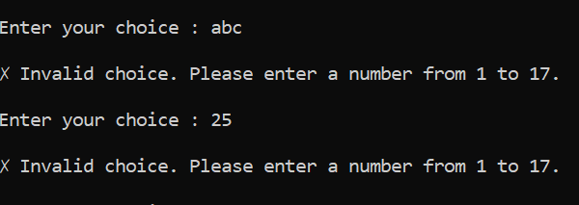
Testing and Validation
✓ Create File
✓ Create Folder
Test: invalid input
✓ Delete File
✓ Delete Folder
✓ Copy
✓ Move
✓ Rename
✓ Search
✓ Permissions
✓ Preview
✓ Tree View
✓ Invalid Input
24

Slide 25
Results and Evaluation
✓ FUNCTIONALITY
✓ CORRECTNESS
✓ USABILITY
File/directory operations execute correctly
Filesystem changes validated
Fewer commands to remember
Unified interface
✓ RELIABILITY
✓ PERFORMANCE
Sample results
✓ Folder created successfully.
✓ File copied successfully.
✗ Invalid choice.
✓ Search completed.
Invalid input handled
Missing files handled
Permission errors handled
Fast response
Efficient multi-directory search
25

Slide 26
Key Contribution of FileMaster
FileMaster integrates practical Linux file and directory operations into one unified, beginner-friendly interface.
Traditional Linux CLI
Many commands
FileMaster
One unified menu
POSIX APIs
open, read, rename...
Linux File System
Files and folders
Unified file management
POSIX system-call integration
Recursive operations
Metadata and permissions
Search and visualization
Modular C architecture
Educational OSSP value
26

Slide 27
Future Scope
Planned future work – not implemented
CURRENT FILEMASTER
GUI
Advanced Search
Monitoring
Multi-user
Batch Operations
Graphical User Interface
Advanced Search
Filesystem Monitoring
Multi-user Support
Batch Operations
Improved File Editor
Additional filesystem features
27

Slide 28
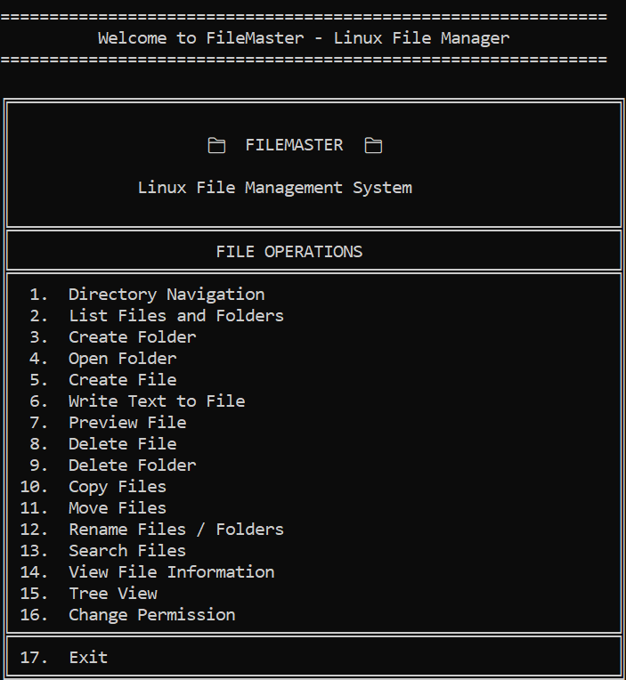
Conclusion
Linux file management system built in C
Common operations in one menu
Menu-driven interface for beginners
Practical POSIX/Linux APIs
Search, metadata, permissions, preview, tree view
Shows OSSP concepts in practice
Modular base for future work
“Simple Interface. Practical Linux File Management.”
28

Slide 29
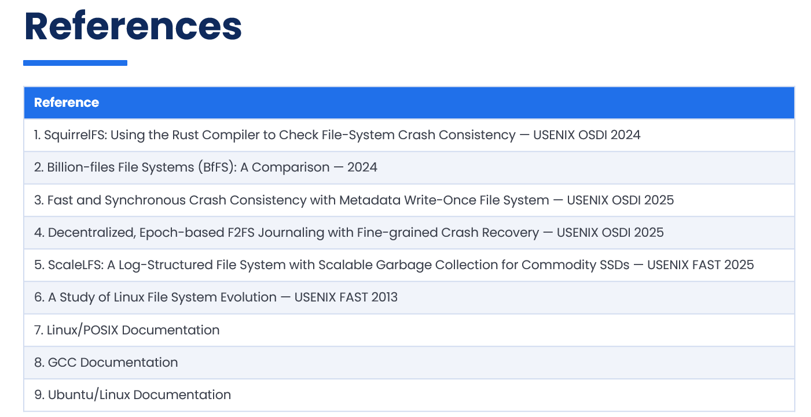
29

Slide 30
x
THANK YOU

